Slide 1
PAYMENT GATEWAY
USING PAYPAL API
Developed By:
IT033 Dhwani Shah
IT032 Krusha Dhamsaniya
Guided By:
Dr. Vipul Dabhi
Dr. Harshad Prajapti

Slide 2
FLOW DIAGRAM

Slide 3



CUSTOMER
1. Submit the form by filling payment details.
FRONTEND
(HTML/CSS)
5. If success get payment details
BACKEND
(SPRINGBOOT)
4. Display success/failed
2. Redirect to Paypal API (login page)
PAYPAL
3. Generate payment id and payment status

Slide 4
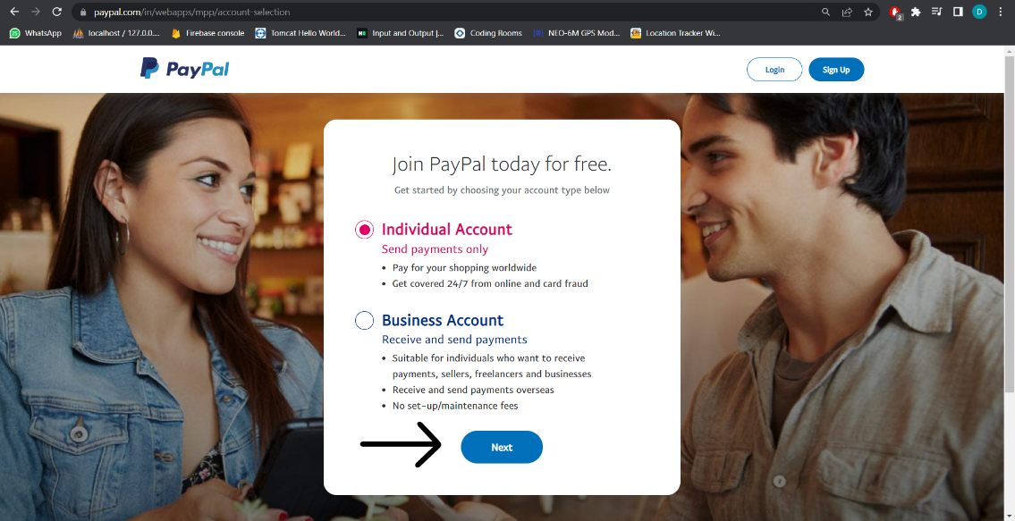
Setting up PayPal Account
Open https://www.paypal.com/in/webapps/mpp/account-selection and create Individual account in it. Now click on Next.

Slide 5
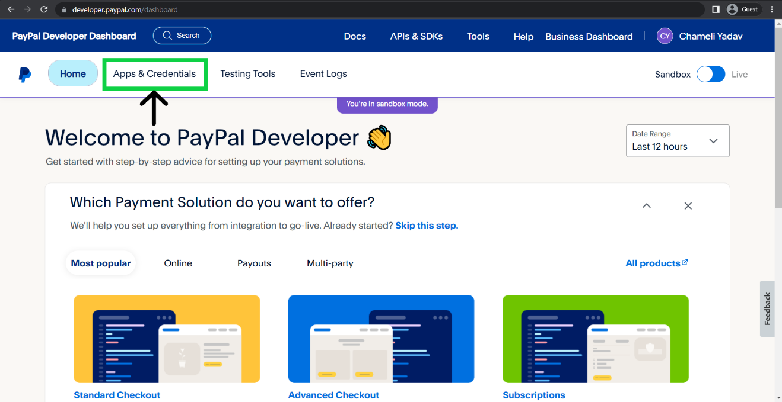
Once account is created, go to https://developer.paypal.com/home.
Log in to dashboard and go to Apps & Credentials.
Create an app from REST API Apps section.

Slide 6
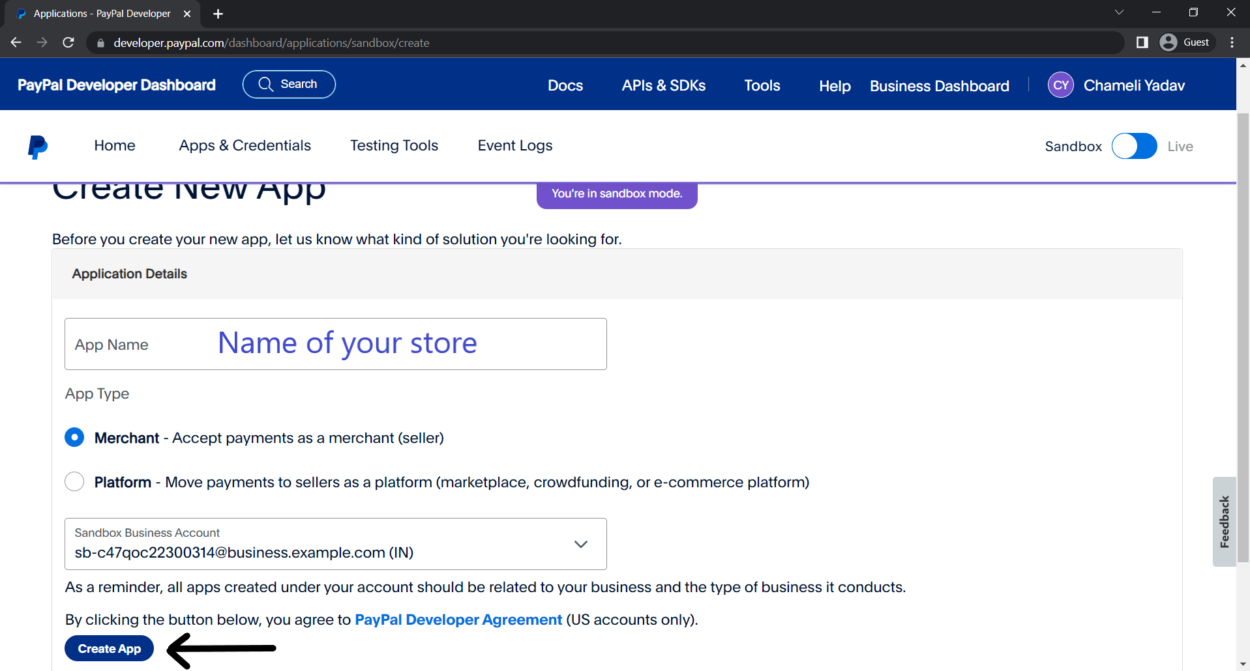
Enter app name and select merchant option and then create the app.
Open the created app from the same section after it is created.

Slide 7
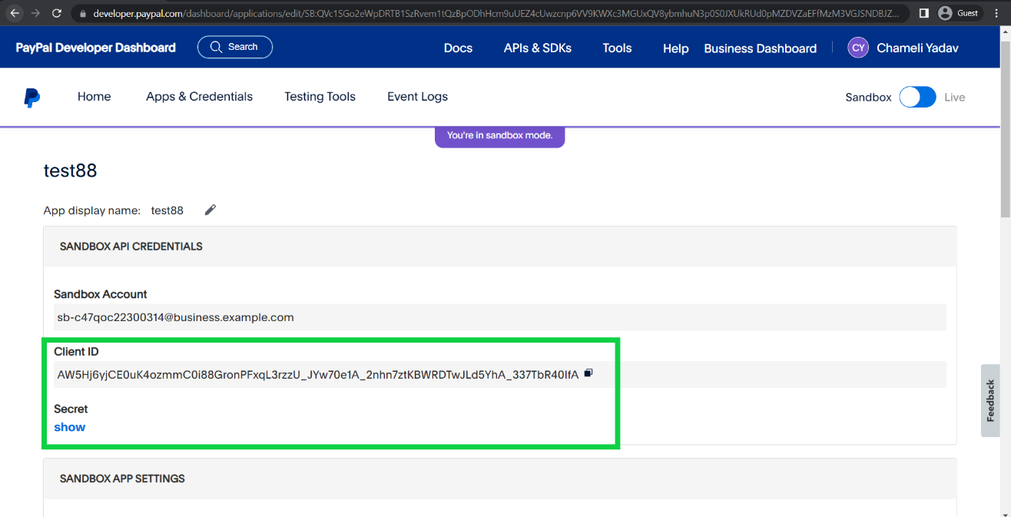
Copy paste the Client ID and Secret to a notepad file.

Slide 8
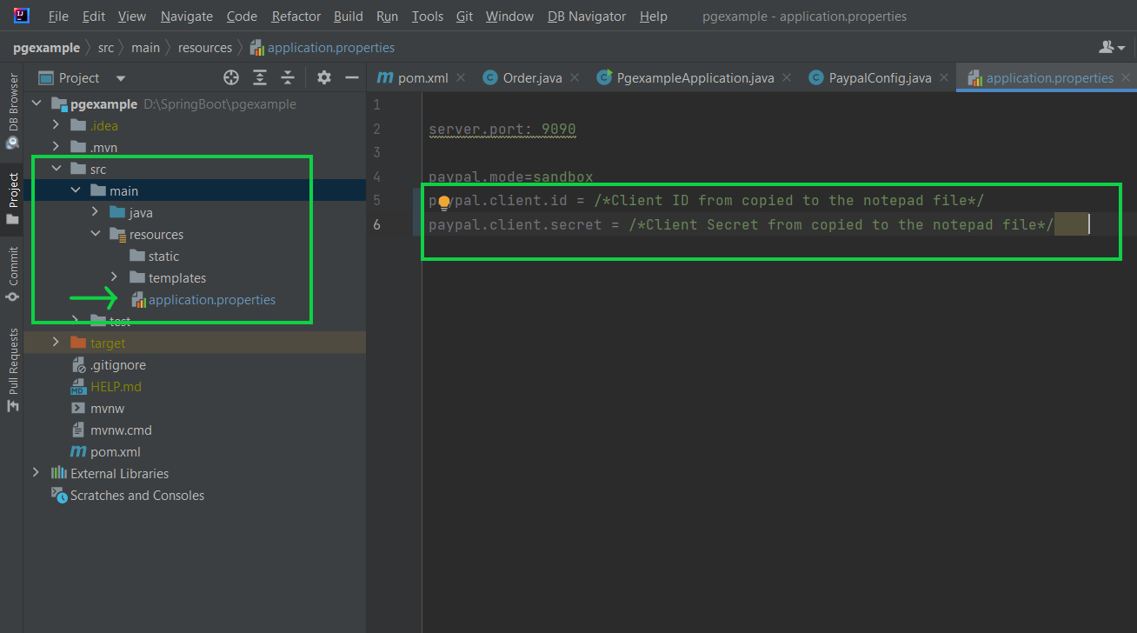
Go to src>main>templates>application.properties file
Copy Paste the Client ID and Secret from the notepad file to paypal.client.id and paypal.client.secret.

Slide 9
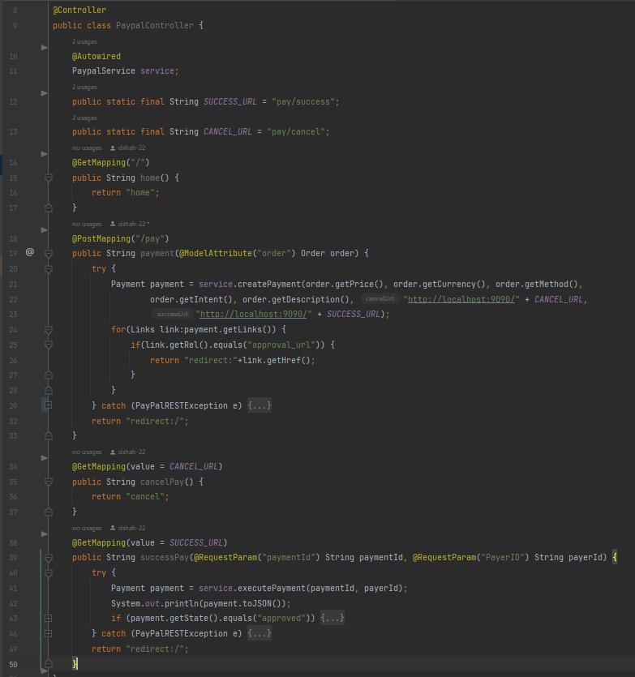
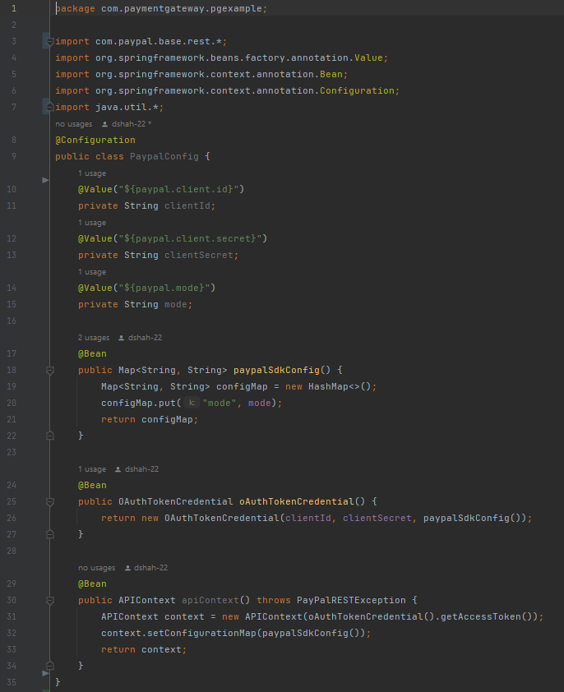
Controller class
Configuration class

Slide 10
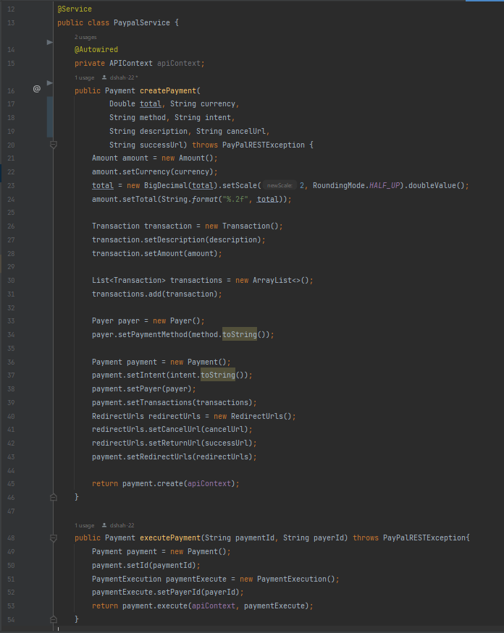
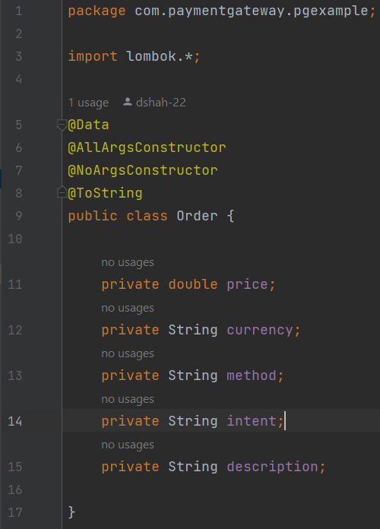
Order class
Service class

Slide 11
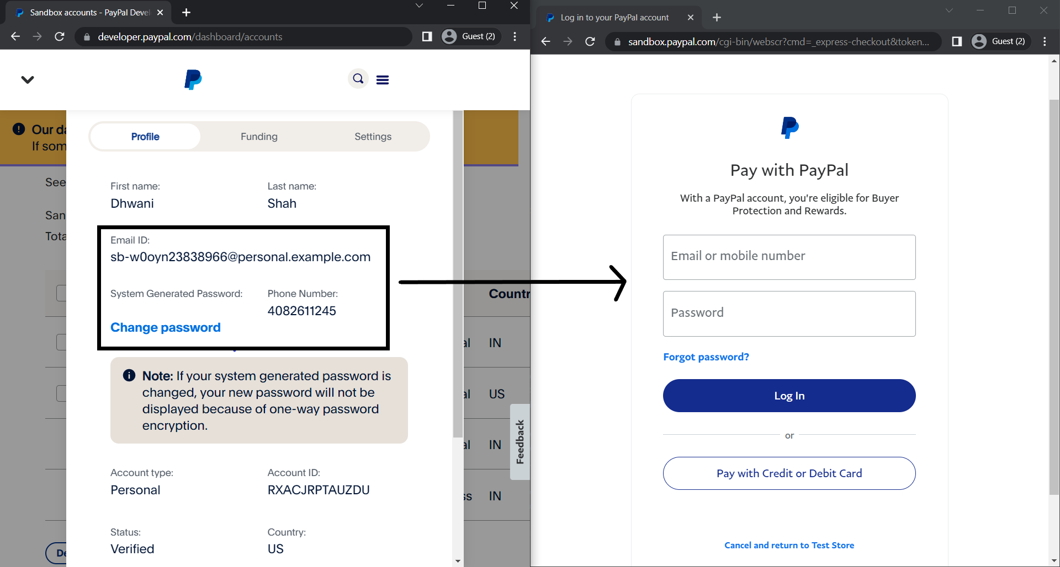
Run the application at localhost:9090 and click on continue button after filling the form.
Add SandBox accounts credentials to the paypal page generated after filling the form.
Login after filling the details.

Slide 12
REFERENCES
https://youtu.be/GykDyG0ELms
https://blog.saleslayer.com/how-to-add-paypal-payment-gateway-ecommerce

Slide 13
THANK YOU
GitHub Repo URL : https://github.com/dshah-22/Payment-Gateway

